Slide 1
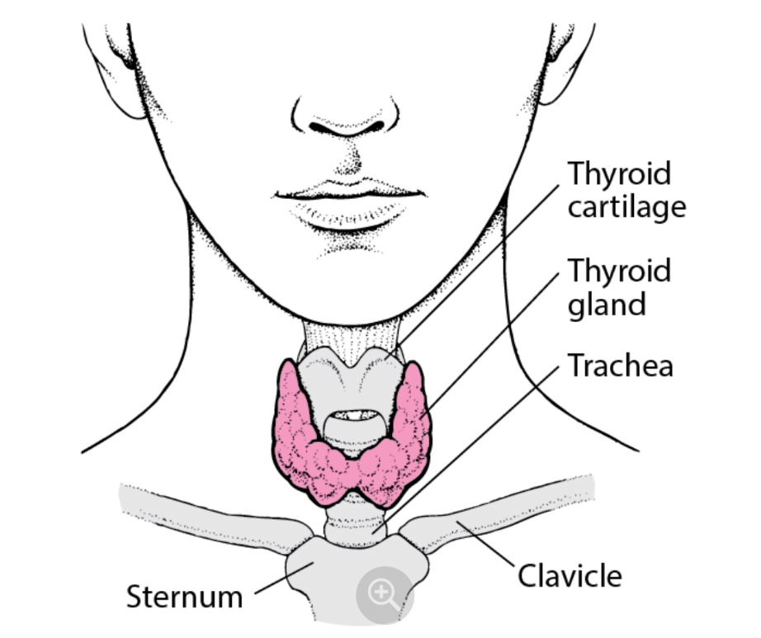
DETAILED PROJECT REPORT
On
THYROID DISEASE DETECTION
Made By –
ANKIT SINGH

Slide 2

ABSTRACT
Thyroid gland plays a major role in maintaining the metabolism of human body. Data mining in health care industry provides a systematic use of the medical data.
Thyroid diseases are most common today. Early changes in the thyroid gland will not affect the proper working of the gland.
By the early identification of thyroid disorders, better treatment can be provided in the early stage thus can avoid thyroid replacement therapy and thyroid removal up to an extent.

Slide 3
INTRODUCTION
The thyroid gland is a small organ that’s located in the front of the neck, wrapped around the windpipe (trachea).
It’s shaped like a butterfly, smaller in the middle with two wide wings that extend around the side of your throat.
The thyroid is a gland. You have glands throughout your body, where they create and release substances that help your body do a specific thing.
Your thyroid makes hormones that help control many vital functions of your body.
If your body makes too much thyroid hormone, you can develop a condition called ‘hyperthyroidism’. If your body makes too little thyroid hormone, it’s called ‘hypothyroidism’.

Slide 4
Business Problem
Thyroid disease is a common cause of medical diagnosis and prediction, with an onset that is difficult to forecast in medical research.
The thyroid gland is one of our body's most vital organs. Thyroid hormone releases are responsible for metabolic regulation.
Hyperthyroidism and hypothyroidism are one of the two common diseases of the thyroid that releases thyroid hormones in regulating the rate of body's metabolism.
The main goal is to predict the estimated risk on a patient's chance of obtaining thyroid disease or not.

Slide 5
AIM
The aim of this project is to predict the risk of hypothyroid and hyperthyroid in a patient.
BENEFITS
Non-invasive: Detection of Thyroid disease
Saves Time: Easy to use and access
Less intervention of doctor

Slide 6
PROPOSED METHOD
In the proposed method, we are performing Data pre-processing step, in which feature engineering, feature selection, feature scaling steps are performed and then we are doing model building and performance testing.
We are using different classification algorithms to classify the thyroid disease type.

Slide 7
Architecture
Database
(UCI Repository)
Data Collection
EDA
Feature Engineering
Model Saving
Model Performance
Model Creation
Feature Selection
User Interface Designing
Flask API Development
User Data Validation
Model Deployment
Cloud Setup

Slide 8
DATASET
Thyroid Disease Dataset taken from UCI Machine Learning Repository: URL: https://archive.ics.uci.edu/ml/datasets/thyroid+disease
Total patients = 2800
Healthy Subjects = 2503
Abnormal Subjects = 297
Numerical Features: age, TSH, T3, T4U, FTI
Categorical Features: sex, on_thyroxine, query_on_thyroxine, on_anti_thyroid_medication, sick, pregnant, thyroid_surgery, I131_treatment, query_hypothyroid, query_hyperthyroid, lithium, goitre, tumor, hypopituitary, psych, labels

Slide 9
ML Model Building Workflow
Data Pre-Processing
Dropping the irrelevant features from the dataset
Separating the numerical and categorical features
Handling missing values in numerical features using median
Handling missing values in categorical features using mode
Numerical features transformation using ‘Log’ and ‘Square Root’ Transformation
Encoding categorical features using ‘One-Hot-Encoding’ and ‘Label Encoding’
Checking multi-collinearity and dropping highly correlated independent features

Slide 10
ML Model Building Workflow
Model Creation and Evaluation
Different classification algorithms like Decision Tree, Random Forest, K-NN, XGBoost, etc. created and tested
Random Forest, XGBoost, Decision Tree were produced good result
XGBoost as the best model chosen for training and testing purpose
Model performance evaluated based on Accuracy, Confusion Matrix, Recall

Slide 11
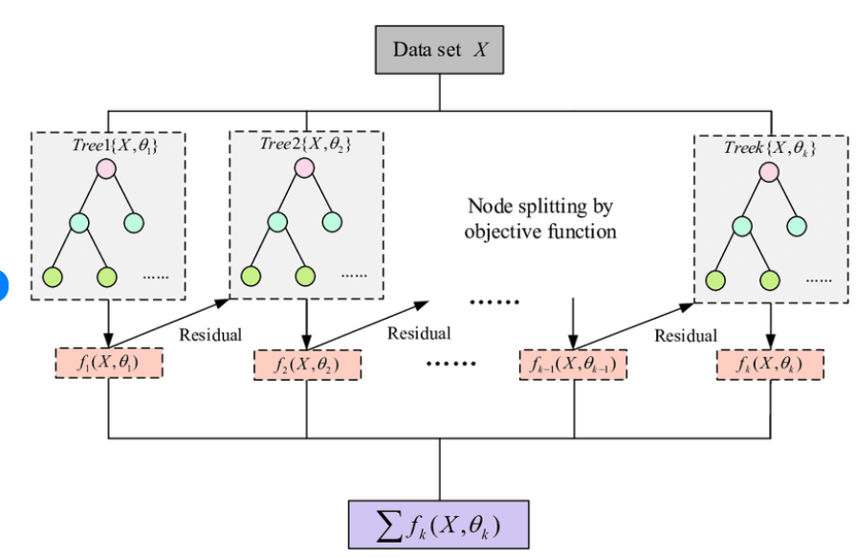
RANDOM FOREST CLASSIFIER
XGBoost (eXtreme Gradient Boosting) is a powerful and efficient machine learning algorithm widely used for classification and regression tasks.
It is an implementation of gradient boosted decision trees designed for speed and performance. XGBoost builds an ensemble of trees in a sequential manner, where each new tree corrects the errors made by the previous ones.
It employs a gradient descent algorithm to minimize the loss function, making it highly effective in capturing complex patterns in data.
Key features of XGBoost include regularization to prevent overfitting, handling missing values, parallel processing, and optimized use of hardware resources.
These attributes make XGBoost a preferred choice for many competitive machine learning tasks and real-world applications, often outperforming other algorithms in both accuracy and speed.
XGBoost

Slide 12
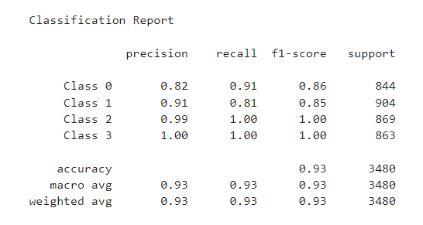
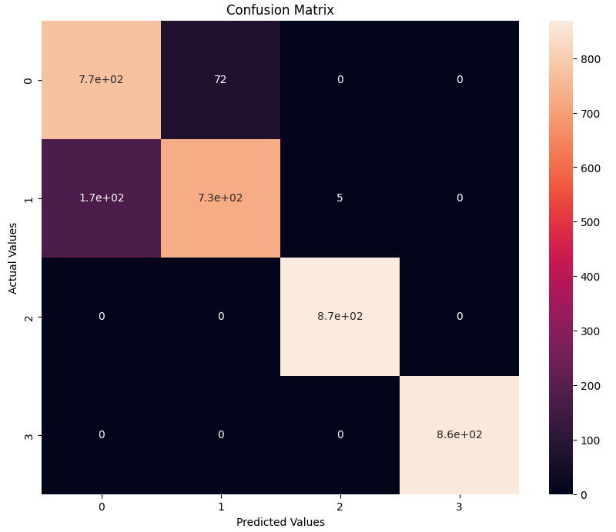
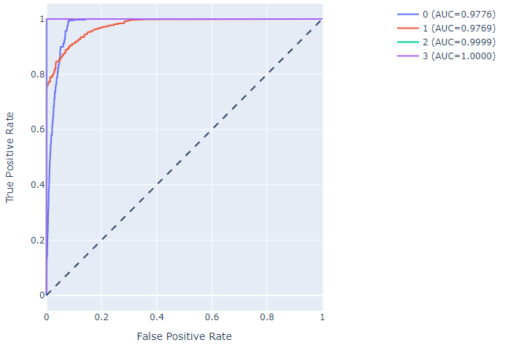
Prediction Result on Test Data
Classification Report
Confusion Matrix
ROC Curve
Where 0: Compensated Hypothyroid, 1: Negative, 2: Primary Hypothyroid, 3:Secondary Hyperthyroid

Slide 13
SOFTWARES
PyCharm is used as IDE.
Matplotlib and Seaborn are used for visualization of the plots.
Azure is used for deployment of the model.
Front-end development is done using html, CSS, bootstrap
Flask is used for backend development and for API development.
GitHub is used as version control system.

Slide 14
DEPOLYMENT
The final model is deployed on Heroku Cloud URL: https://thyroiddetect.azurewebsites.net/

Slide 15
FAQs
Q1) What is the source of data? A1) The dataset is obtained from famous machine learning repository. UCI Machine Learning Repository: https://archive.ics.uci.edu/ml/datasets/thyroid+disease
Q2) What was the type of data?
A2) The dataset was the combination of Numerical and Categorical features.
Q3) What’s the complete flow you followed in this Project?
A3) Refer slide 7th for better understanding of the project and flow
Q4) What techniques were you using for data pre-processing?
Dropping the irrelevant features from the dataset
Separating the numerical and categorical features
Handling missing values in numerical features using median
Handling missing values in categorical features using mode
Numerical features transformation using ‘Log’ and ‘Square Root’ Transformation
Encoding categorical features using ‘One-Hot-Encoding’ and ‘Label Encoding’
Checking multi-collinearity and dropping highly correlated independent features

Slide 16
FAQs
Q5) How training was done or what models were used?
A5) First Data pre-processing done on final CSV file after cleaning the dataset. After that we did exploratory data analysis and feature selection and then different ML model such as Decision Tree, Random Forest and XGBoost are trained and based on performance we selected the best model.
Q6) How Prediction was done?
A6) The testing files are shared by the client. We perform the same life cycle and then loaded the best model and perform prediction. In the end we get the prediction.
Q7) What are the different stages of deployment?
A7) After model training and finalizing a model, we created required files for deployment. And finally deployed our model over Heroku.
Q8) How is the User Interface present for this project?
A8) UI is very user friendly and easy to use. URL: https://thyroiddetect.azurewebsites.net/

Slide 17
REFERENCES
[1] K. Chandel, V. Kunwar, S. Sabitha, T. Choudhury, S. Mukherjee, “A comparative study on thyroid disease detection using K-nearest neighbor and Naive Bayes classification techniques”, pp. 1-7, 2017.
[2] H. Kumar H S, “A Novel Approach of SVM based Classification on Thyroid Disease Stage Detection”, pp. 836-841, 2020.
[3] S. Razia, M. R. N. Rao, “Machine Learning Techniques for Thyroid Disease Diagnosis - A Review”, vol. 9(28), pp. 1-9, 2016.
[4] Z. Parry and R. Macnab, “Thyroid disease and thyroid surgery,” Anaesthesia & Intensive Care Medicine, vol. 18, no. 10, pp. 488–495, 2017.View at: Publisher Site | Google Scholar
[5] G. Serpen, H. Jiang, and L. Allred, “Performance analysis of probabilistic potential function neural network classifier,” in Proceedings of Artificial Neural Networks in Engineering Conference, vol. 7, pp. 471–476, St. Louis, MO, USA, 1997.View at: Google Scholar
[6] Ozyilmaz and T. Yildirim, “Diagnosis of thyroid disease using artificial neural network methods,” in Proceedings of International Conference on Neural Information Processing, pp. 2033–2036, Singapore, 2002.View at: Google Scholar
[7] E. Dogantekin, A. Dogantekin, and D. Avci, “An expert system based on generalized discriminant analysis and wavelet support vector machine for diagnosis of thyroid diseases,” Expert Systems with Applications, vol. 38, no. 1, pp. 146–150, 2011.View at: Publisher Site | Google Scholar
[8] H.-L. Chen, B. Yang, G. Wang, J. Liu, Y.-D. Chen, and D.-Y. Liu, “A three-stage expert system based on support vector machines for thyroid disease diagnosis,” Journal of Medical Systems, vol. 36, no. 3, pp. 1953–1963, 2011.View at: Publisher Site | Google Scholar

